Slide 1
Intermediate SQL

Slide 2
Joined Relations
Join operations take two relations and return as a result another relation.
A join operation is a Cartesian product which requires that tuples in the two relations match. It also specifies the attributes that are present in the result of the join
The join operations are typically used as subquery expressions in the from clause

Slide 3
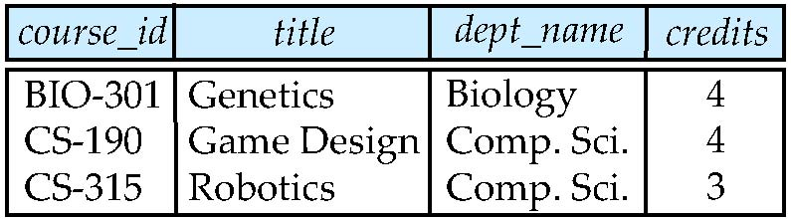
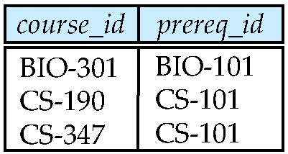
Join operations – Example
Relation course
Relation prereq

Slide 4
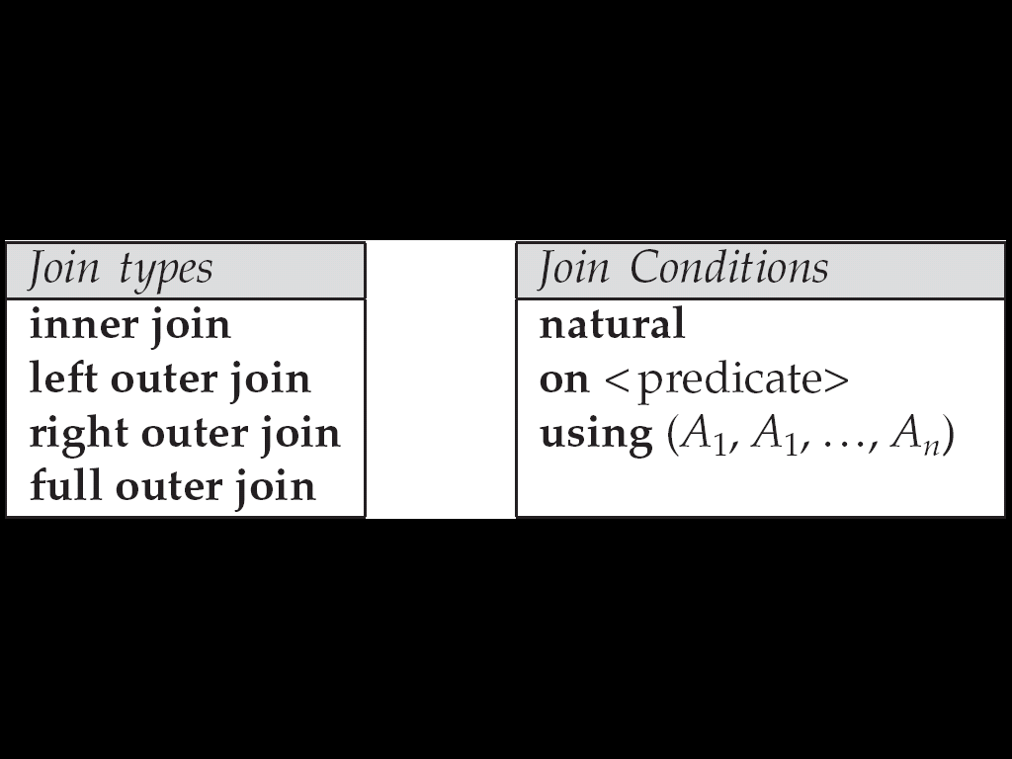
Joined Relations
Join condition – defines which tuples in the two relations match, and what attributes are present in the result of the join.
Join type – defines how tuples in each relation that do not match any tuple in the other relation (based on the join condition) are treated.

Slide 5
Outer Join
An extension of the join operation that avoids loss of information.
Computes the join and then adds tuples form one relation that does not match tuples in the other relation to the result of the join.
Uses null values.

Slide 6
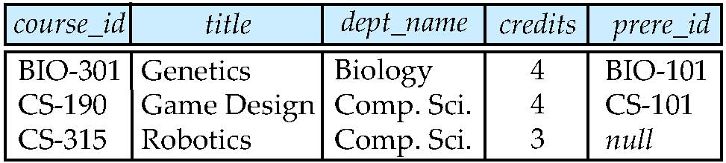
Left Outer Join
course natural left outer join prereq

Slide 7
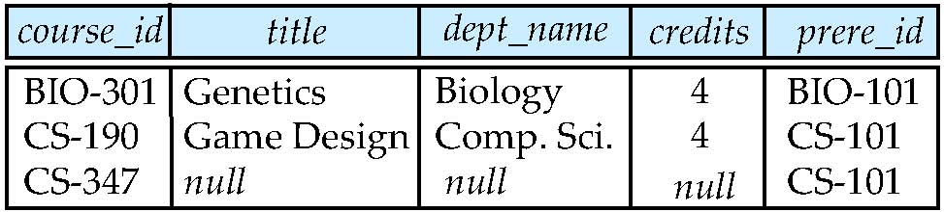
Right Outer Join
course natural right outer join prereq

Slide 8
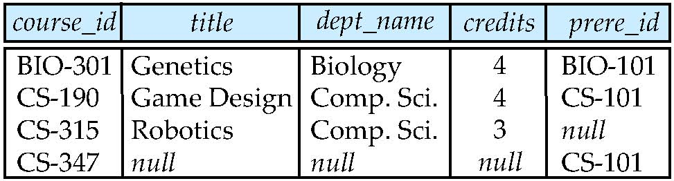
Full Outer Join
course natural full outer join prereq

Slide 9
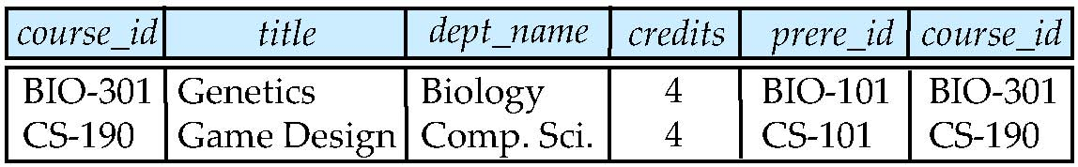
Joined Relations – Examples
course inner join prereq on course.course_id = prereq.course_id

Slide 10
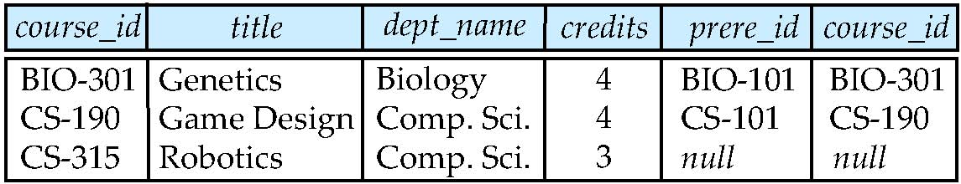
Joined Relations – Examples
What is the difference between the above, and a natural join?
course left outer join prereq on course.course_id = prereq.course_id

Slide 11
Joined Relations – Examples
course natural right outer join prereq
course full outer join prereq using (course_id)

Slide 12
Relational Algebra
Procedural language
Six basic operators
select: σ
project: ∏
union: ∪
set difference: –
Cartesian product: x
rename: ρ
The operators take one or two relations as inputs and produce a new relation as a result.

Slide 13
Select Operation
Notation: σ _{p}(r)
p is called the selection predicate
Defined as: σ_{p}(r) = {t | t ∈ r and p(t)}
Where p is a formula in propositional calculus consisting of terms connected by : ∧ (and), ∨ (or), ¬ (not)

Slide 14
Select Operation
Each term is one of:
<attribute> op <attribute> or <constant>
where op is one of: = , ≠ , > , ≥ , < , ≤
Example of selection: σ _{dept_name=“Physics”} (instructor)

Slide 15
Project Operation
Notation:
where A₁, A₂ are attribute names and r is a relation name.
The result is defined as the relation of k columns obtained by erasing the columns that are not listed

Slide 16
Project Operation
Duplicate rows removed from result, since relations are sets
Example: To eliminate the dept_name attribute of instructor ∏_{ID, name, salary} (instructor)

Slide 17
Union Operation
Notation: r ∪ s
Defined as:
r ∪ s = {t | t ∈ r or t ∈ s}

Slide 18
Union Operation
For r ∪ s to be valid.
1. r, s must have the same arity (same number of attributes)
2. The attribute domains must be compatible (example: 2nd column of r deals with the same type of values as does the 2nd column of s)

Slide 19
Union Operation
Example: to find all courses taught in the Fall 2009 semester, or in the Spring 2010 semester, or in both ∏_{course_id} (σ _{semester=“Fall” Λ year=2009} (section)) ∪ ∏_{course_id} (σ _{semester=“Spring” Λ year=2010} (section))

Slide 20
Set Difference Operation
Notation r – s
Defined as:
r – s = {t | t ∈ r and t ∉ s}
Set differences must be taken between compatible relations.
r and s must have the same arity
attribute domains of r and s must be compatible

Slide 21
Set Difference Operation
Example: to find all courses taught in the Fall 2009 semester, but not in the Spring 2010 semester ∏_{course_id} (σ _{semester=“Fall” Λ year=2009} (section)) − ∏_{course_id} (σ _{semester=“Spring” Λ year=2010} (section))

Slide 22
Set-Intersection Operation
Notation: r ∩ s
Defined as:
r ∩ s = { t | t ∈ r and t ∈ s }
Assume:
r, s have the same arity
attributes of r and s are compatible
Note: r ∩ s = r – (r – s)

Slide 23
Cartesian-Product Operation
Notation r x s
Defined as:
r x s = {t q | t ∈ r and q ∈ s}
Assume that attributes of r(R) and s(S) are disjoint. (That is, R ∩ S = ∅).
If attributes of r(R) and s(S) are not disjoint, then renaming must be used.

Slide 24
Rename Operation
Allows us to name, and therefore to refer to, the results of relational-algebra expressions.
Allows us to refer to a relation by more than one name.
Example:
ρ _{x} (E)
returns the expression E under the name X

Slide 25
Rename Operation
If a relational-algebra expression E has arity n, then
returns the result of expression E under the name X, and with the attributes renamed to A₁ , A₂ , …., A_{n} .

Slide 26
Formal Definition
A basic expression in the relational algebra consists of either one of the following:
A relation in the database
A constant relation

Slide 27
Formal Definition
Let E₁ and E₂ be relational-algebra expressions; the following are all relational-algebra expressions:
E₁ ∪ E₂
E₁ – E₂
E₁ x E₂
σ_{p} (E₁), P is a predicate on attributes in E₁
∏_{s}(E₁), S is a list consisting of some of the attributes in E₁
ρ _{x} (E₁), x is the new name for the result of E₁

Slide 28
Tuple Relational Calculus
A nonprocedural query language, where each query is of the form
{t | P (t ) }
It is the set of all tuples t such that predicate P is true for t
t is a tuple variable, t [A ] denotes the value of tuple t on attribute A
t ∈ r denotes that tuple t is in relation r
P is a formula similar to that of the predicate calculus

Slide 29
Predicate Calculus Formula
1. Set of attributes and constants
2. Set of comparison operators: (e.g., <, ≤, =, ≠, >, ≥)
3. Set of connectives: and (∧), or (v)‚ not (¬)
4. Implication (⇒): x ⇒ y, if x if true, then y is true
x ⇒ y ≡ ¬ x v y
5. Set of quantifiers:
∃ t ∈ r (Q (t )) ≡ ”there exists” a tuple in t in relation r such that predicate Q (t ) is true
∀t ∈ r (Q (t )) ≡ Q is true “for all” tuples t in relation r

Slide 30
Example Queries
Find the ID, name, dept_name, salary for instructors whose salary is greater than $80,000
Notice that a relation on schema (ID, name, dept_name, salary) is implicitly defined by the query
As in the previous query, but output only the ID attribute value
{t | ∃ s ∈ instructor (t [ID ] = s [ID ] ∧ s [salary ] > 80000)}
Notice that a relation on schema (ID) is implicitly defined by the query
{t | t ∈ instructor ∧ t [salary ] > 80000}

Slide 31
Example Queries
Find the names of all instructors whose department is in the Watson building
{t | ∃s ∈ instructor (t [name ] = s [name ] ∧ ∃u ∈ department (u [dept_name ] = s[dept_name] “ ∧ u [building] = “Watson” ))}

Slide 32
Example Queries
Find the set of all courses taught in the Fall 2009 semester, or in the Spring 2010 semester, or both
{t | ∃s ∈ section (t [course_id ] = s [course_id ] ∧ s [semester] = “Fall” ∧ s [year] = 2009) v ∃u ∈ section (t [course_id ] = u [course_id ] ∧ u [semester] = “Spring” ∧ u [year] = 2010 )}

Slide 33
Example Queries
Find the set of all courses taught in the Fall 2009 semester, and in the Spring 2010 semester
{t | ∃s ∈ section (t [course_id ] = s [course_id ] ∧ s [semester] = “Fall” ∧ s [year] = 2009) ∧ ∃u ∈ section (t [course_id ] = u [course_id ] ∧ u [semester] = “Spring” ∧ u [year] = 2010 )}

Slide 34
Example Queries
Find the set of all courses taught in the Fall 2009 semester, but not in the Spring 2010 semester
{t | ∃s ∈ section (t [course_id ] = s [course_id ] ∧ s [semester] = “Fall” ∧ s [year] = 2009 ∧ ¬ ∃u ∈ section (t [course_id ] = u [course_id ] ∧ u [semester] = “Spring” ∧ u [year] = 2010 )}

Slide 35
Universal Quantification
Find all students who have taken all courses offered in the Biology department
{t | ∃ r ∈ student (t [ID] = r [ID]) ∧ (∀ u ∈ course (u [dept_name]=“Biology” ⇒ ∃ s ∈ takes (t [ID] = s [ID ] ∧ s [course_id] = u [course_id]))}

Slide 36
Safety of Expressions
It is possible to write tuple calculus expressions that generate infinite relations.
For example, { t | ¬ t ∈ r } results in an infinite relation if the domain of any attribute of relation r is infinite
To guard against the problem, we restrict the set of allowable expressions to safe expressions.

Slide 37
Safety of Expressions (Cont.)
An expression {t | P (t )} in the tuple relational calculus is safe if every component of t appears in one of the relations, tuples, or constants that appear in P
NOTE: this is more than just a syntax condition.
E.g. { t | t [A] = 5 ∨ true } is not safe --- it defines an infinite set with attribute values that do not appear in any relation or tuples or constants in P.

Slide 38
Safety of Expressions (Cont.)
Consider again that query to find all students who have taken all courses offered in the Biology department
{t | ∃ r ∈ student (t [ID] = r [ID]) ∧ (∀ u ∈ course (u [dept_name]=“Biology” ⇒ ∃ s ∈ takes (t [ID] = s [ID ] ∧ s [course_id] = u [course_id]))}
Without the existential quantification on student, the above query would be unsafe if the Biology department has not offered any courses.

Slide 39
Domain Relational Calculus
A nonprocedural query language equivalent in power to the tuple relational calculus
Each query is an expression of the form:
{ < x₁, x₂, …, x_{n} > | P (x₁, x₂, …, x_{n})}
x₁, x₂, …, x_{n} represent domain variables
P represents a formula similar to that of the predicate calculus

Slide 40
Example Queries
Find the ID, name, dept_name, salary for instructors whose salary is greater than $80,000
{< i, n, d, s> | < i, n, d, s> ∈ instructor ∧ s > 80000}
As in the previous query, but output only the ID attribute value
{< i> | < i, n, d, s> ∈ instructor ∧ s > 80000}

Slide 41
Example Queries
Find the names of all instructors whose department is in the Watson building
{< n > | ∃ i, d, s (< i, n, d, s > ∈ instructor ∧ ∃ b, a (< d, b, a> ∈ department ∧ b = “Watson” ))}

Slide 42
Example Queries
Find the set of all courses taught in the Fall 2009 semester, or in the Spring 2010 semester, or both
{<c> | ∃ a, s, y, b, r, t ( <c, a, s, y, b, r, t > ∈ section ∧ s = “Fall” ∧ y = 2009 ) v ∃ a, s, y, b, r, t ( <c, a, s, y, b, r, t > ∈ section ] ∧ s = “Spring” ∧ y = 2010)}
This case can also be written as
{<c> | ∃ a, s, y, b, r, t ( <c, a, s, y, b, r, t > ∈ section ∧ ( (s = “Fall” ∧ y = 2009 ) v (s = “Spring” ∧ y = 2010))}

Slide 43
Example Queries
Find the set of all courses taught in the Fall 2009 semester, and in the Spring 2010 semester
{<c> | ∃ a, s, y, b, r, t ( <c, a, s, y, b, r, t > ∈ section ∧ s = “Fall” ∧ y = 2009 ) ∧ ∃ a, s, y, b, r, t ( <c, a, s, y, b, r, t > ∈ section ] ∧ s = “Spring” ∧ y = 2010)}

Slide 44
Safety of Expressions
The expression:
{ < x₁, x₂, …, x_{n} > | P (x₁, x₂, …, x_{n} )}
is safe if all of the following hold:
All values that appear in tuples of the expression are values from dom (P ) (that is, the values appear either in P or in a tuple of a relation mentioned in P ).
For every “there exists” subformula of the form ∃ x (P₁(x )), the subformula is true if and only if there is a value of x in dom (P₁) such that P₁(x ) is true.
For every “for all” subformula of the form ∀_{x} (P₁ (x )), the subformula is true if and only if P₁(x ) is true for all values x from dom (P₁).

Slide 45
Universal Quantification
Find all students who have taken all courses offered in the Biology department
{< i > | ∃ n, d, tc ( < i, n, d, tc > ∈ student ∧ (∀ ci, ti, dn, cr ( < ci, ti, dn, cr > ∈ course ∧ dn =“Biology” ⇒ ∃ si, se, y, g ( <i, ci, si, se, y, g> ∈ takes ))}
Note that without the existential quantification on student, the above query would be unsafe if the Biology department has not offered any courses.

